Slide 1
Boston Crime Report Analysis

Slide 2

How A Crime Is Reported?
The crime is given a incident number.
It comes under what offense code is noted.
The offense code is categorized under offense code group and offense code description is given.
Date, Time and Location of the incident is noted .

Slide 3



Why Analysis is required?
To analyze the yearly ascend or descend trend of crime.
To find crime hot spots.
Frequency of crimes according to month and day.
The above analysis would help police, decide their plan of action.
Identification safe localities/green zones.

Slide 4
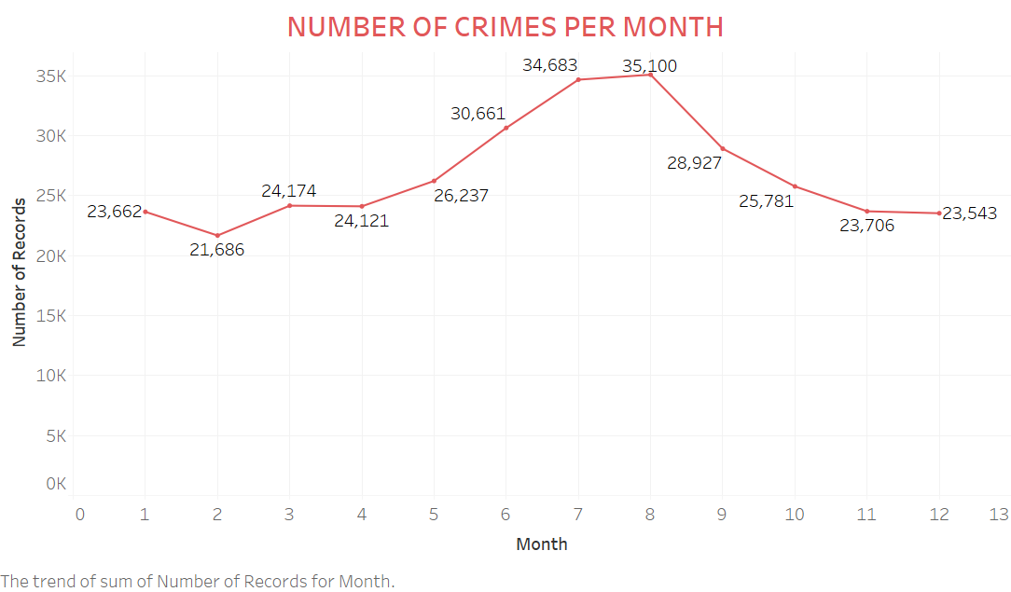
MONTHLY ANALYSIS
Which month has the highest number of crime.
From the graph we can see that month July and August recorded highest number of crimes.
There is lesser weather constraints during these months so the number of crimes committed are more.

Slide 5
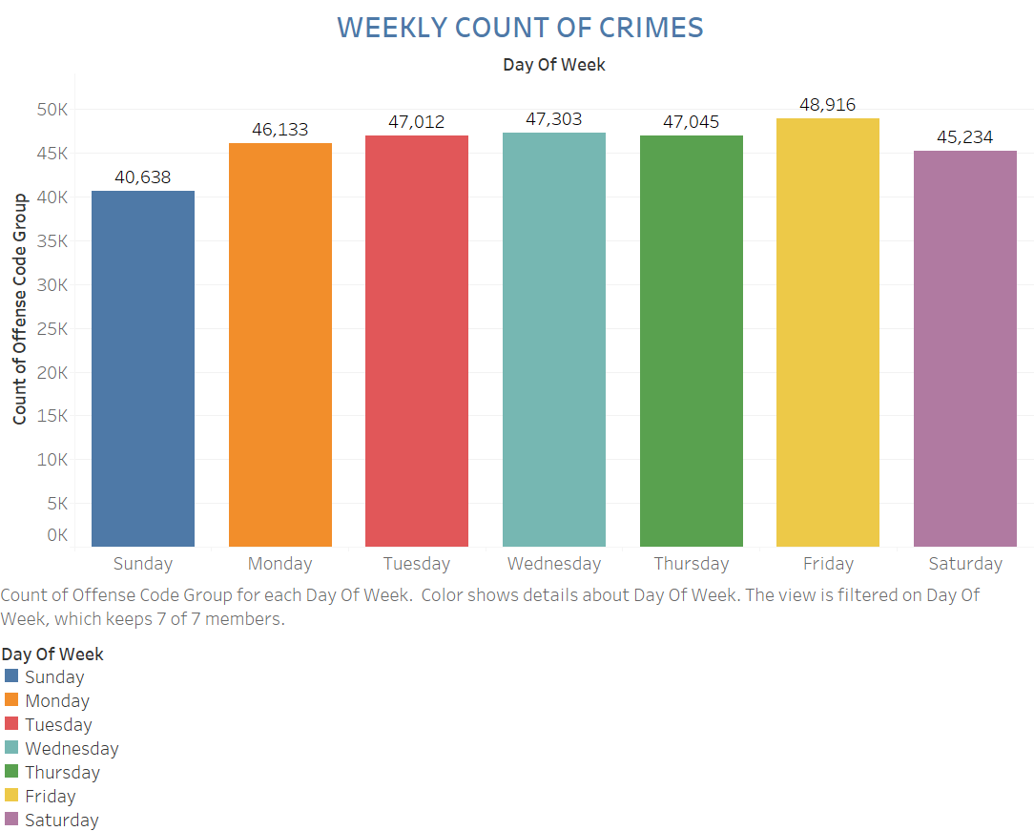
WEEKLY ANALYSIS
There is no clear cut indication of any particular day of the week susceptible to highest number of crime.
The trend seems to show higher criminal acts happening throughout the weekdays compare to weekends with Friday being an exception.
Fridays tend to have high amount of parties compare to other days which might be resulting in higher number of crimes.

Slide 6
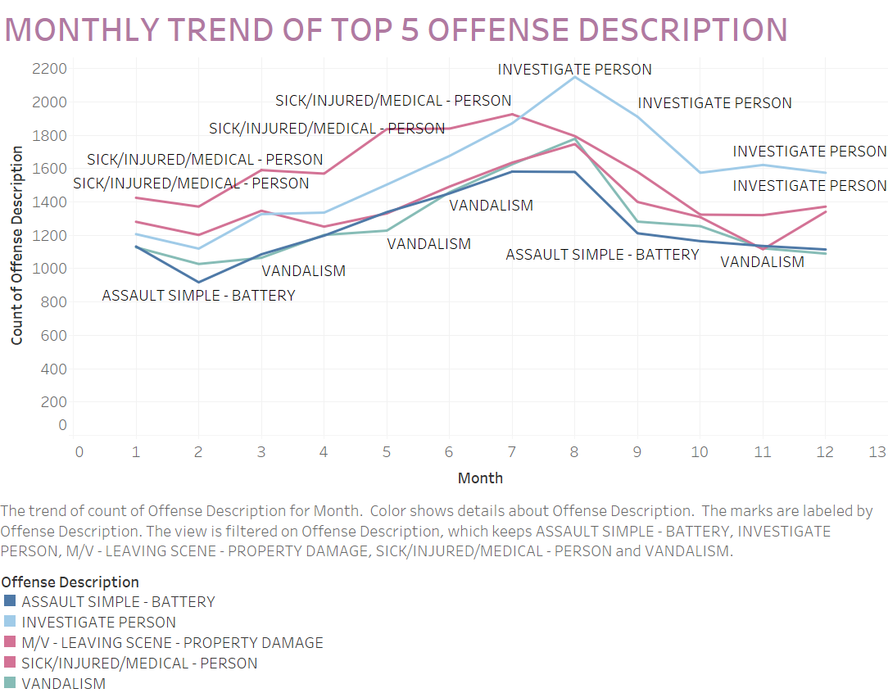
TOP 5 OFFENSE DESCRIPTION
Offense description means actions taken after a particular offense is done.
These are top 5 actions taken in case of crime.
Every month the actions are different.
Most action taken is to investigate a person.
This action is the first step for mostly every crime committed.

Slide 7
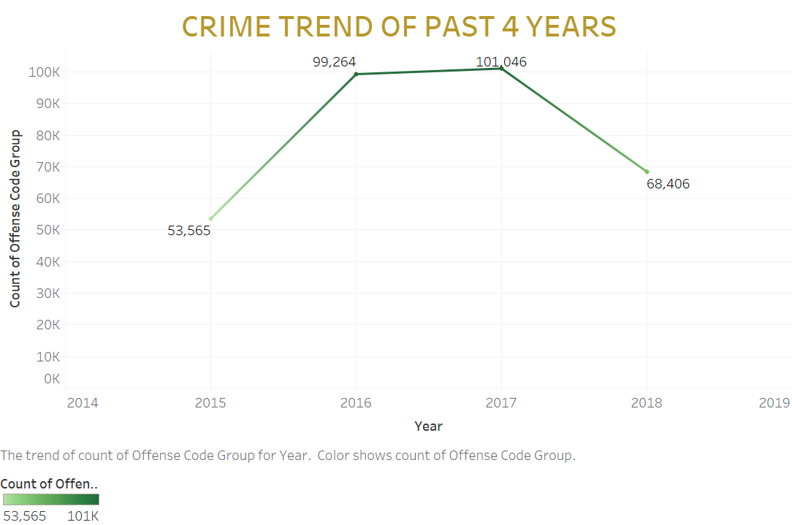
YEARLY ANALYSIS
Graph shows yearly trend of crimes for past 4 years.
The trend is a increased crime rate in past 2 years and it has dropped in this year.
We can say the measures taken by officials are working and they can continue with these actions for a safe city.

Slide 8


REPORT CONCLUSION
People commit more crime when there are no weather constraints.
Partying days like Friday is more targeted by criminals.
After a crime the first action taken in most incidents are to investigate a person
The crime rate this year has decreased a lot compared to previous 2 years.
Officials are taking right measures as the crime rate has decreased.
People should also be careful and together make a safe city.

Slide 9
THANK YOU
If any questions
Email_id : padale.k@husky.neu.edu
Contact : 617-438-5828

